Slide 1
DIP Seminar Week 1
최성욱

Slide 2
Contents
1. Affine Transform
Scaling, Rotation, Translation, Shear , ···
2. Intensity Transform
Negative, Log, Gamma, ···
3. Spatial Filtering
Smoothing, Sharpening
4. Color Transform
RGB-to-HSI, HSI-to-RGB

Slide 3
1. Affine Transform

Slide 4
Theory (1) - Geometric spatial transformations and image registration
Geometric transformations modify the spatial relationship between pixels in an image
a geometric transformation consists of two basic operations: (1) a spatial transformation of coordinates and (2) intensity interpolation that assigns intensity values to the spatially transformed pixels.

Slide 5
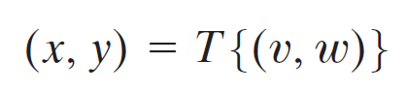
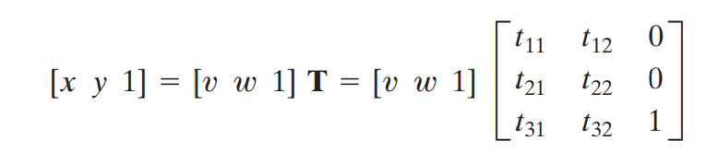
Theory (2) - Geometric spatial transformations and image registration
The transformation of coordinates may be expressed as
And the affine transform has the general form,
Affine transformation can scale, rotate, translate, or sheer a set of coordinate points,depending on the value chosen for the elements of matrix T.
The real power of the matrix representation is that it provides the framework for concatenating together a sequence of operations.

Slide 6
Theory(3) – forward mapping vs inverse mapping
forward mapping consists of scanning the pixels of the input image and, at each location, computing the spatial location, (x, y), of the corresponding pixel in the output image using (x, y) = T(v, w)
inverse mapping, scans the output pixel locations and, at each location, (x, y), computes the corresponding location in the input image using (v, w) = T⁻¹(x, y). Inverse mapping needs interpolation.

Slide 7
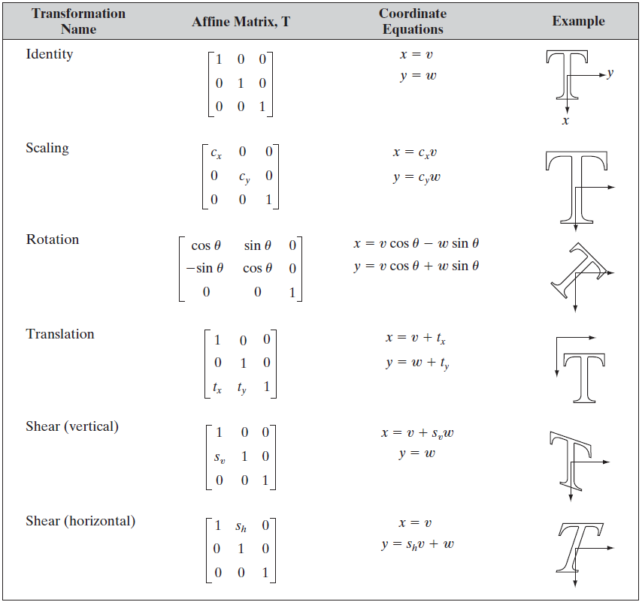
Theory(4) - Affine Matrix Table

Slide 8
Theory(5) - Interpolation
Fundamentally, interpolation is the process of using known data to estimate values at unknown locations.
Nearest neighbor interpolation : we look for new pixel’ closest pixel in the original image and assign the intensity of that pixel to the new pixel
Bilinear interpolation: we use the four nearest neighbors to estimate the intensity at a given location
Bicubic interpolation: we use the sixteen nearest neighbors to estimate the intensity at a given location

Slide 9
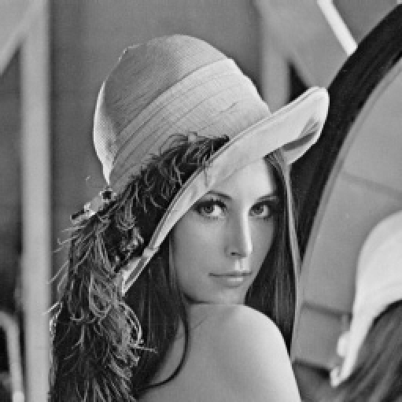
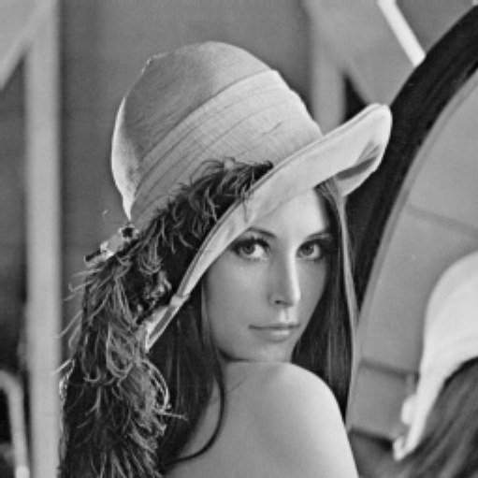


Result(1) - Scaling
Original Image(256x256)
2x Magnified Image using nearest neighborhood interpolation. (512x512)
2x Magnified Image using bilinear interpolation. (512x512)

Slide 10


Result(1) - Scaling
Original image(256x256)
Image 2x shrunk and zoomed back to its original size using Nearest Neighborhood interpolation
Image 2x shrunk and zoomed back to its original size using Bilinear interpolation

Slide 11


Result(1) - Scaling
Original image(256x256)
Image 3x shrunk and zoomed back to its original size using NNI
Image 3x shrunk and zoomed back to its original size using BLI

Slide 12

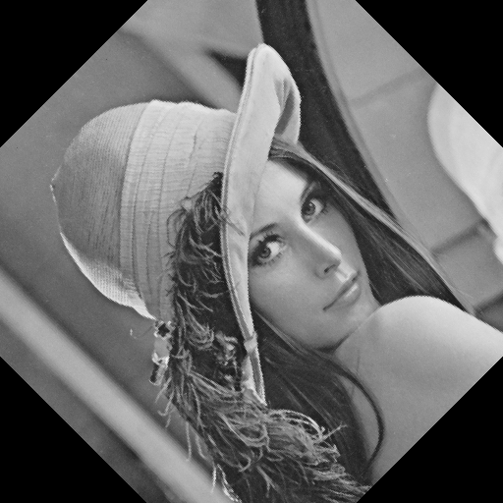
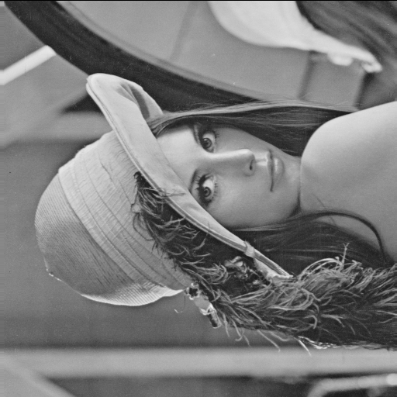
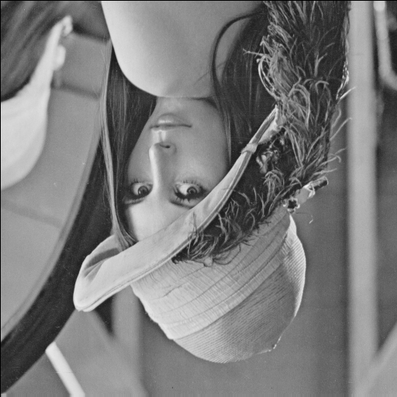
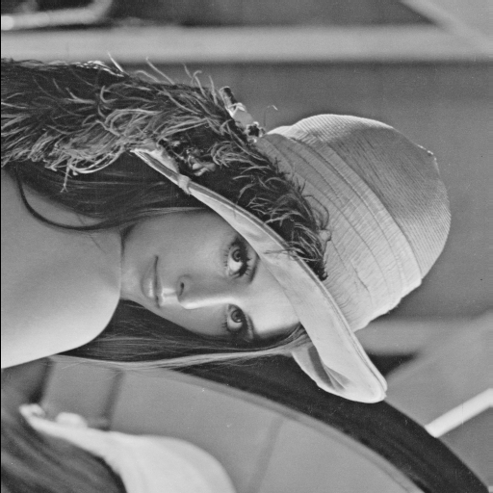
Result(2) - Rotation
Original image
rotated 45°
rotated 90°
rotated 180°
rotated 270°

Slide 13
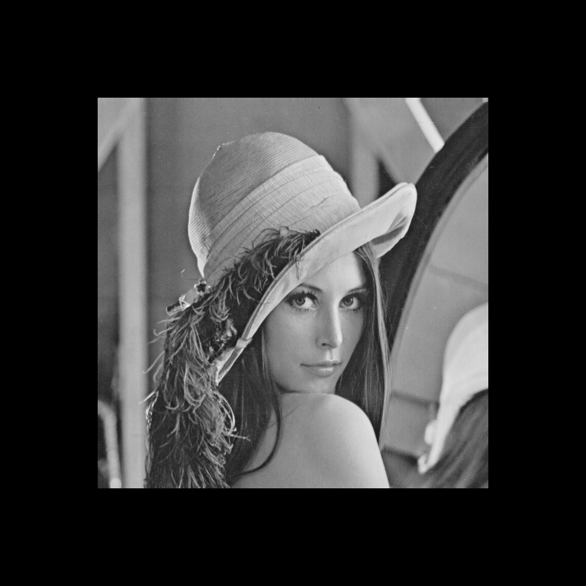
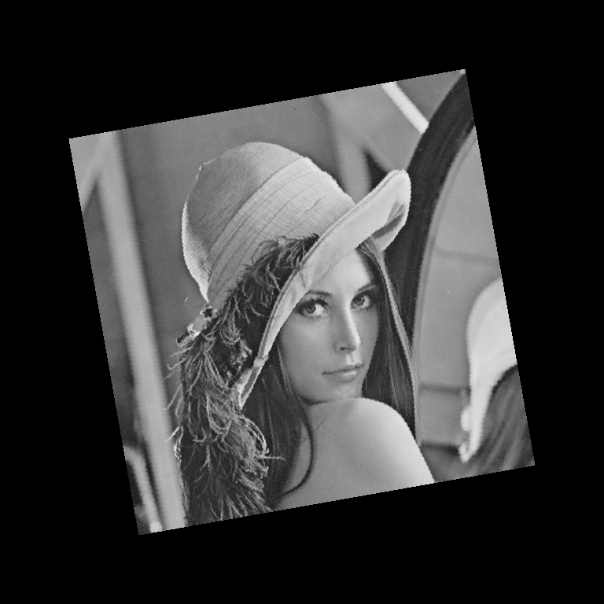
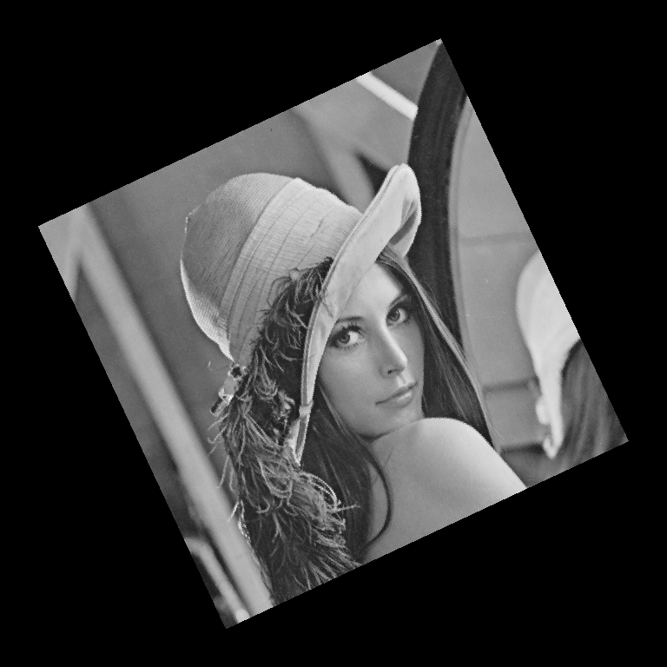
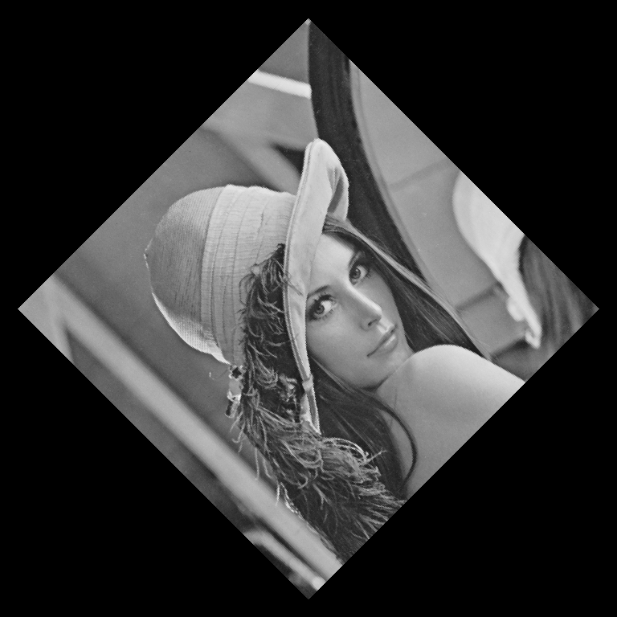
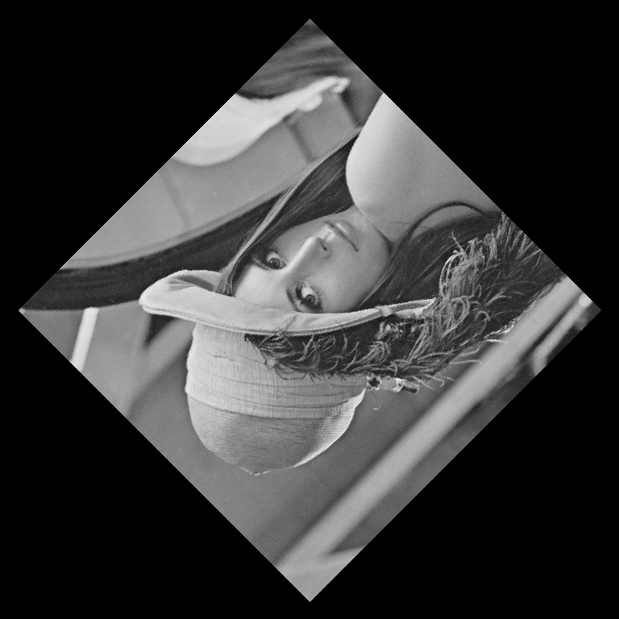
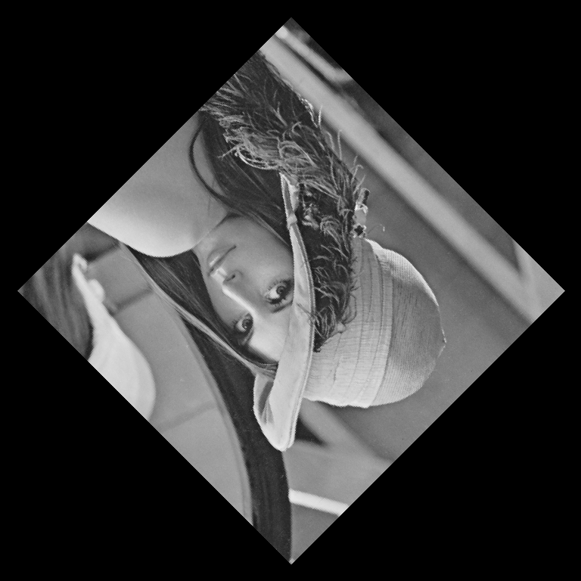
Result(2) - Rotation
Original image
rotated 10°
rotated 25°
rotated 45°
rotated 135°
rotated 225°

Slide 14
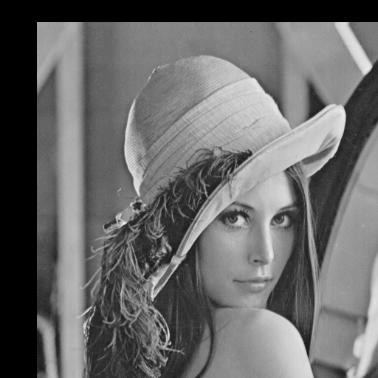
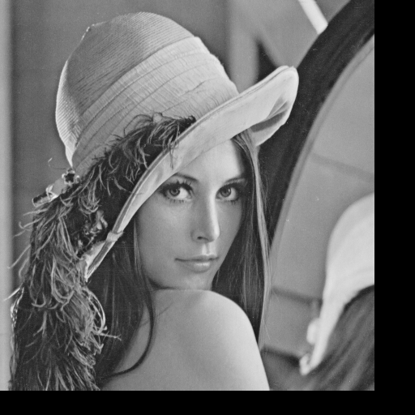
Result(3) - Translation
Original image
Translated Image
(t_{x} =30, t_{x} = 50)
Translated Image
(t_{x} =-50, t_{x} = -30)

Slide 15
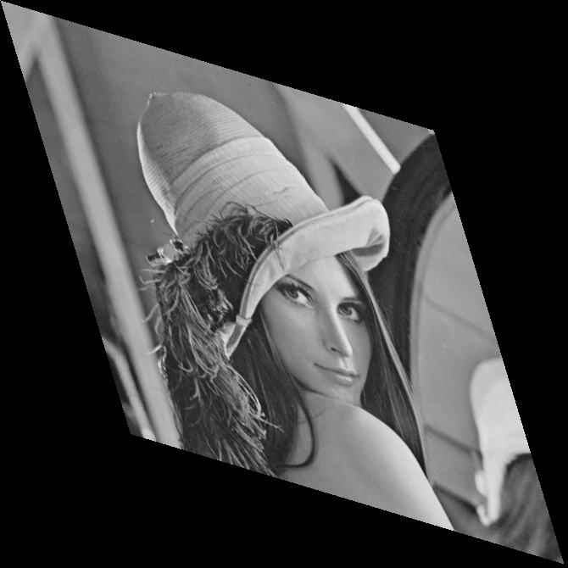
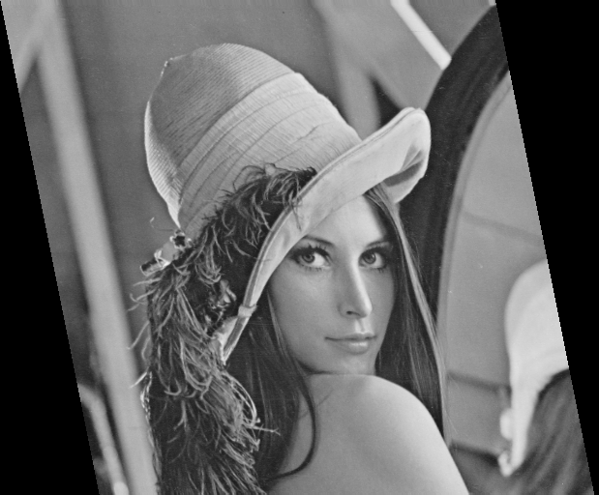
Result(4) - Shear
Original image
Horizontally Sheared Image(s_{h} = 0.2)
Horizontally & Verticatlly Sheared Image(s_{h} = s_{v} = 0.3)

Slide 16
2. Intensity Transform

Slide 17
Theory(1) -The Basics of Intensity Transformations and Spatial Filtering
The spatial domain processes can be denoted by the expression,
g(x, y) = T[ f(x, y)] (1)
where f(x, y) is the input image, is the output image, and T is an operator on f defined over a neighborhood of point (x, y)
The smallest possible neighborhood is of size 1 x 1. In this case, g depends only on the value of f at a single point (x, y) and T in Eq. (1) becomes an intensity transformation function of the form.
s = T(r) (2)
where, for simplicity in notation, s and r are variables denoting, respectively, the intensity of g and f at any point (x, y).

Slide 18
Theory(2) - Some Basic Intensity Transformation Functions
Image Negatives
s = L - 1 – r
where L is maximum intensity value.
This type of processing is particularly suited for enhancing white or gray detail embedded in dark regions of an image.
Log Transformations
s = c log (1 + r)
where c is a constant, and it is assumed that r ≥ 0
this transformation maps a narrow range of low intensity values in the input into a wider range of output levels.
Power-Law (Gamma) Transformations
s = cr^{γ}
where c and γ are positive constants
power-law curves with fractional values of map a narrow range of dark input values into a wider range of output values, with the opposite being true for higher values of input levels.

Slide 19
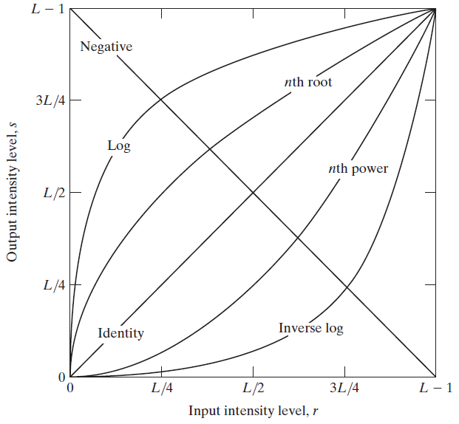
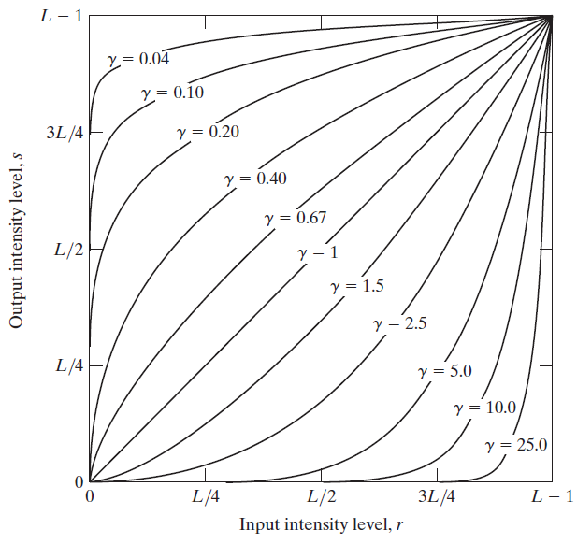
Theory(2) - Some Basic Intensity Transformation Functions
Some basic intensity
Transformation functions
Plots of the equation s = cr^{γ}

Slide 20
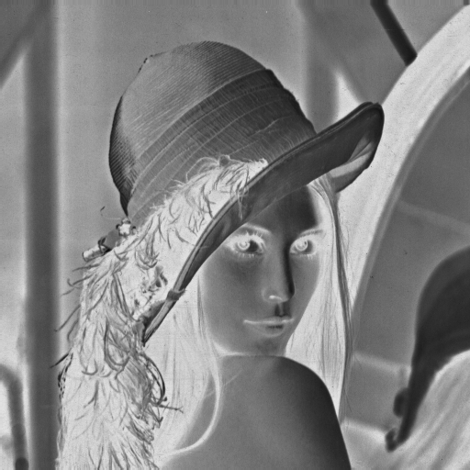
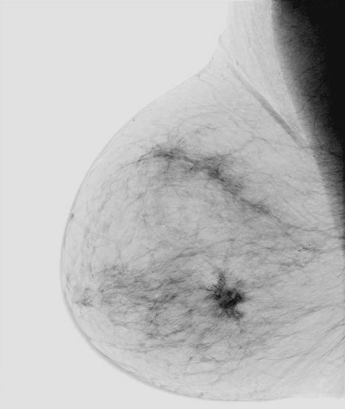
Result(1) – Image Negative
Grayscale image of Lena
Negative image of (a)
Original Digital mammogram
Negative image of (c)
(a)
(b)
(c)
(d)

Slide 21
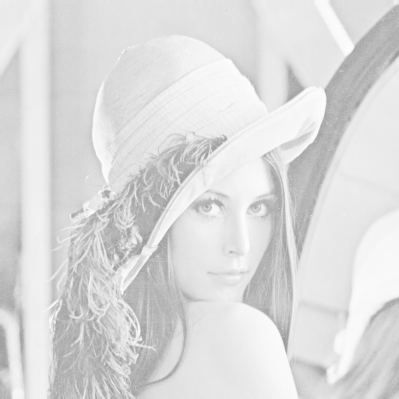
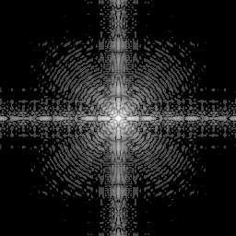
Result(2) – Log Transformation
Grayscale image of Lena
Log transformation of (a) and scaled to 8bits
Fourier spectrum image
Log transformation of (a) and scaled to 8bits
s = c log (1 + r) with c=1
(a)
(b)
(c)
(d)

Slide 22
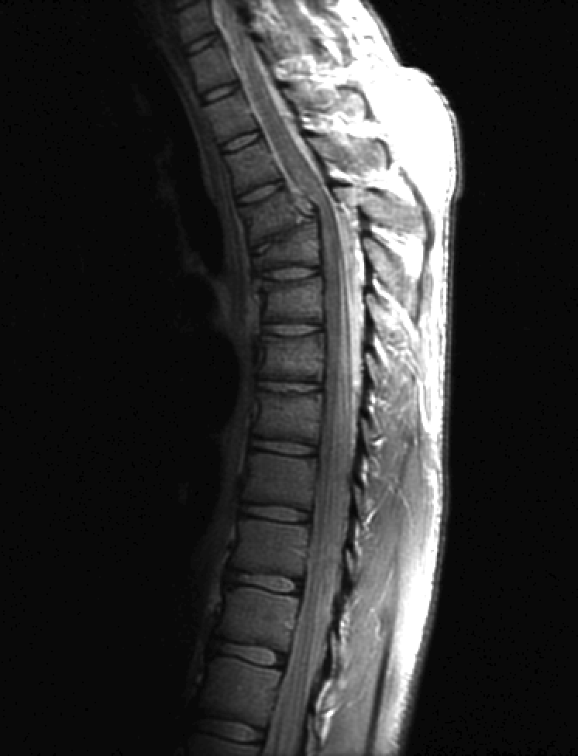
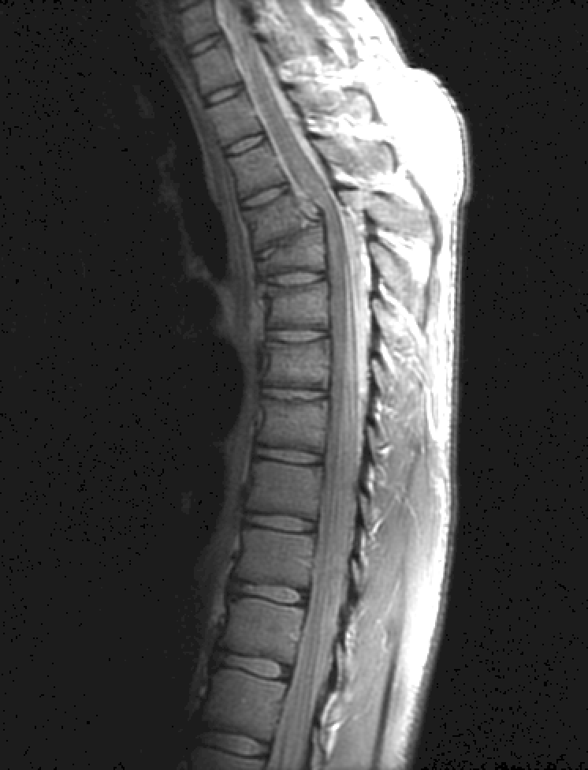
Result(3) – Gamma Transformation
(a)
(b)
(c)
(MRI) of a fractured human spine.
(b) Results of applying gamma transformation of (a) with γ = 0.6
(c) With γ = 0.4

Slide 23
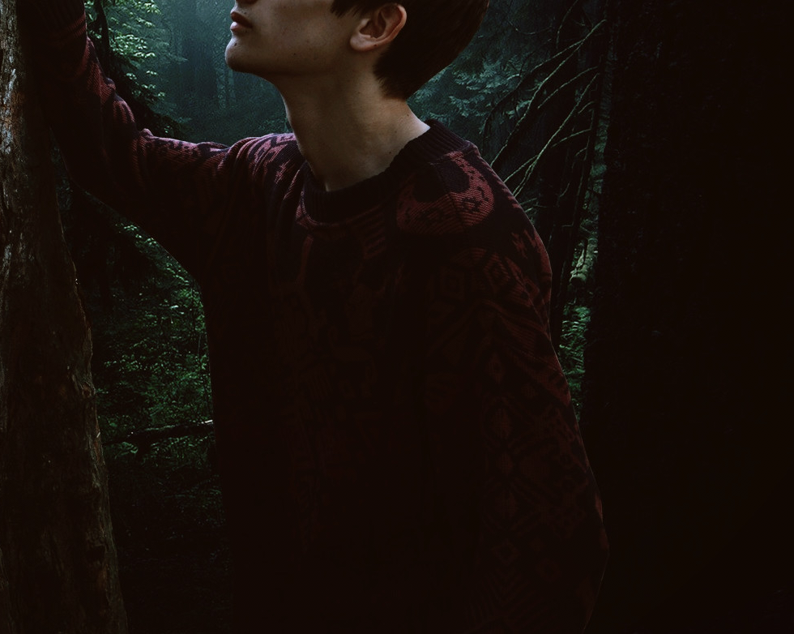


Result(3) – Gamma Transformation
(a)
(b)
(c)
Dark color image
(b) Results of applying gamma transformation of (a) with γ = 0.7
(c) With γ = 0.4

Slide 24
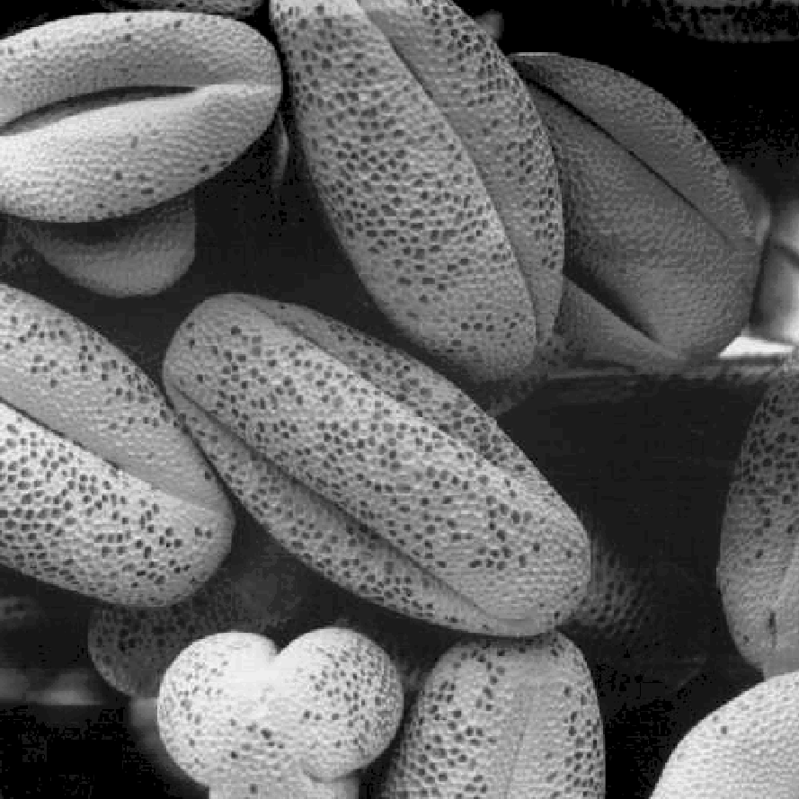
Result(4) – Contrast strectching
A low-contrast image
Result of contrast stretching
(a)
(b)

Slide 25
3. Spatial Filtering

Slide 26
Theory(1) - Fundamentals of Spatial Filtering
a spatial filter consists of (1) a neighborhood, (typically a small rectangle), and (2) a predefined operation that is performed on the image pixels encompassed by the neighborhood.
A processed (filtered) image is generated as the center of the filter visits each pixel in the input image.
If the operation performed on the image pixels is linear, then the filter is called a linear spatial filter. Otherwise, the filter is nonlinear.

Slide 27
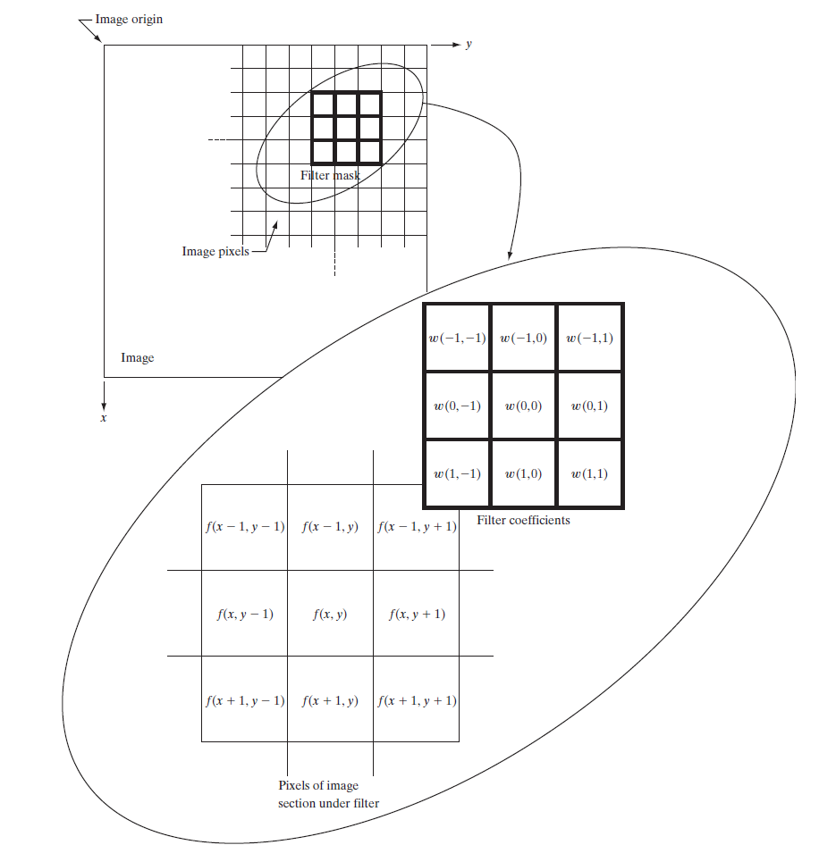
The mechanics of linear spatial filtering using a 3x3 filter mask. The form chosen to denote the coordinates of the filter mask coefficients simplifies writing expressions for linear filtering.

Slide 28
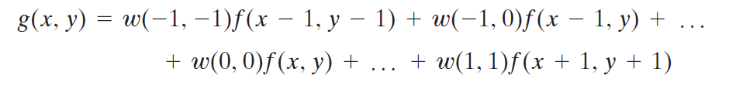
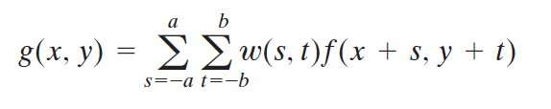
Theory(1) - Fundamentals of Spatial Filtering
At any point (x, y) in the image, the response, g(x, y), of the filter is the sum of products of the filter coefficients and the image pixels encompassed by the filter:
For a mask of size m x n, we assume that m = 2a + 1 and n = 2b + 1, where a and b are positive integers.

Slide 29
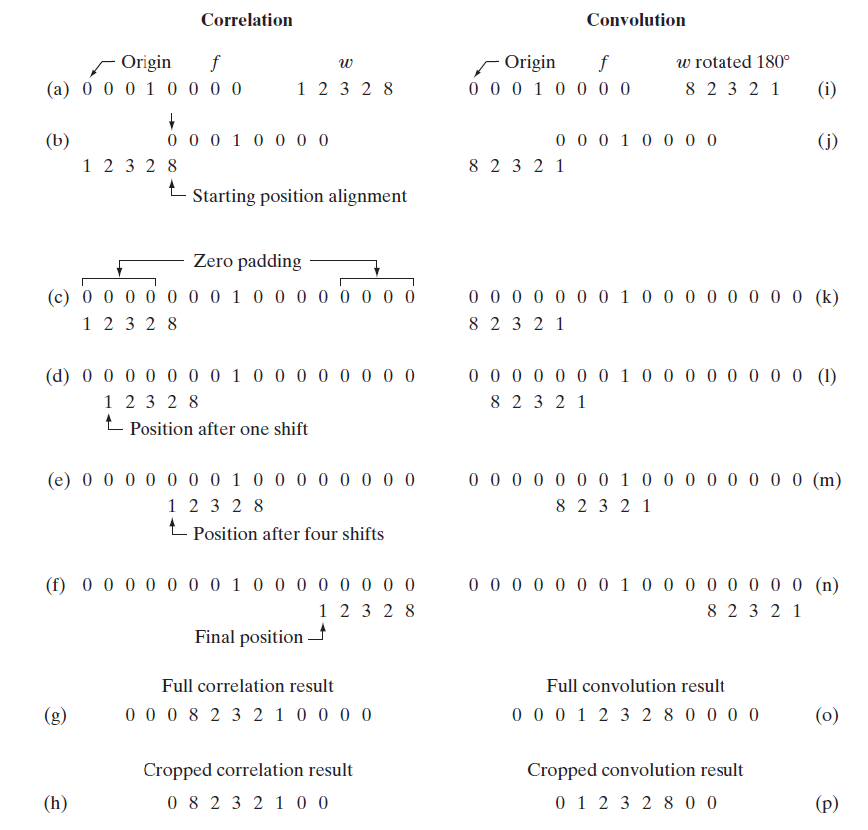
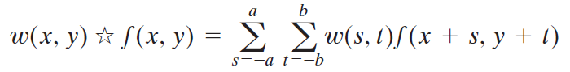
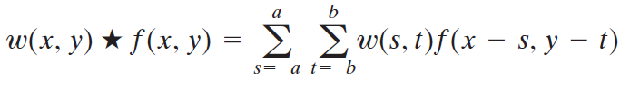
Theory(2) – Spatial Correlation and Convolution
Correlation is the process of moving a filter mask over the image and computing the sum of products at each location, exactly as explained in the previous section.
Convolution mechanics are the same, except that the filter is first rotated by 180°

Slide 30
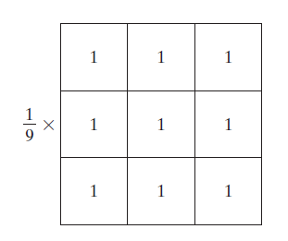
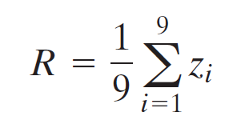
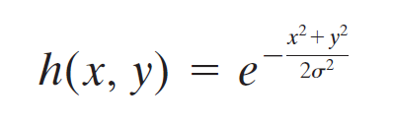
Theory(3) – Smoothing Linear Filters
A spatial averaging filter in which all coefficients are
equal sometimes is called a box filter.
Smoothing filters are used for blurring and for noise reduction.
Generating an m x n linear spatial filter requires that we specify mn mask coefficients.
The average value at any location (x, y) in the image is the sum of the nine intensity values in the neighborhood centered on (x, y) divided by 9. Letting z_{i}, denote these intensities, the average is
In some applications, we have a continuous function of two variables, and the objective is to obtain a spatial filter mask based on that function. For example, a Gaussian function of two variables has the basic form
3x3 box filter

Slide 31
Theory(3) - Order-Statistic (Nonlinear) Filters
Order-statistic filters are nonlinear spatial filters whose response is based on ordering (ranking) the pixels contained in the image area encompassed by the filter, and then replacing the value of the center pixel with the value determined by the ranking result.
Median filter, which, as its name implies, replaces the value of a pixel by the median of the intensity values in the neighborhood of that pixel.
Median filters are particularly effective in the presence of salt-and-pepper noise because of its appearance as white and black dots superimposed on an image.

Slide 32
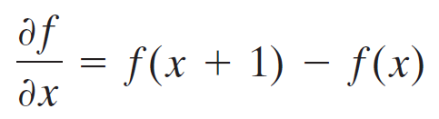
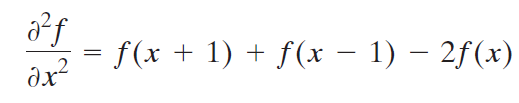
Theory(4) - Sharpening Spatial Filters
The principal objective of sharpening is to highlight transitions in intensity.
There are two types of sharpening filters that are based on first- and second-order derivatives, respectively.
A basic definition of the first-order derivative of a one-dimensional function f(x) is the difference
We define the second-order derivative of as the difference

Slide 33
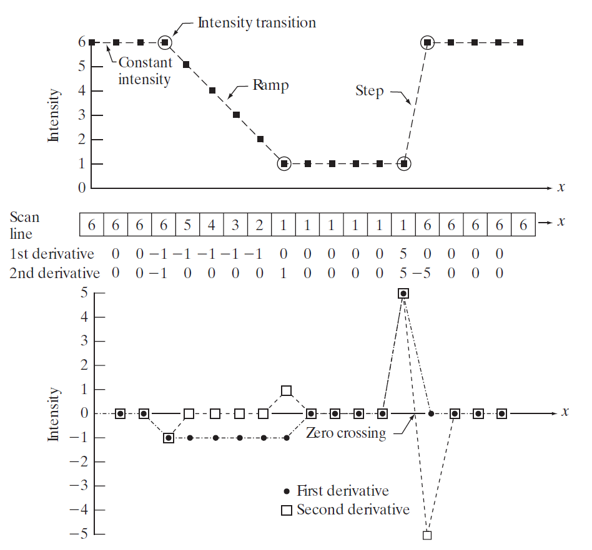
Theory(4) - Sharpening Spatial Filters
Any definition we use for a first derivative (1) must be zero in areas of constant intensity; (2) must be nonzero at the onset of an intensity step or ramp; and (3) must be nonzero along ramps.
Any definition of a second derivative (1) must be zero in constant areas; (2) must be nonzero at the onset and end of an intensity step or ramp; and (3) must be zero along ramps of constant slope.

Slide 34
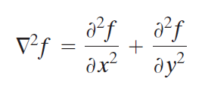
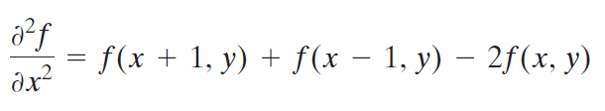
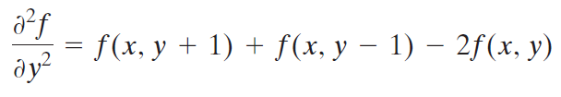
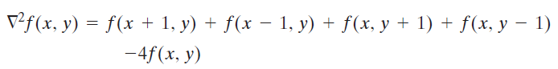
Theory(5) - Using the Second Derivative for Image Sharpening, The Laplacian
The simplest isotropic derivative operator is the Laplacian, which is defined as
In the x-direction,
In the y-direction,
Laplacian of two variables is

Slide 35
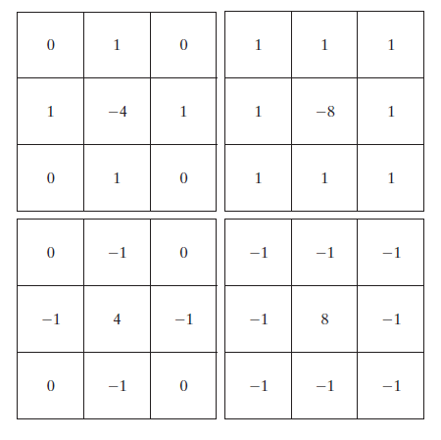
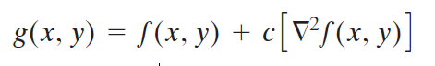
Theory(5) - The Laplacian
a b
c d
(a) Filter mask used
to implement the Laplacian
(b) Mask used to implement an
extension that includes the diagonal terms.
(c) and (d) Two
other implementations
of the Laplacian found frequently in practice.

Slide 36
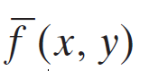
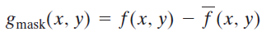
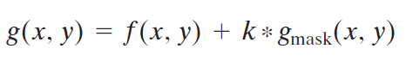
Theory(6) - Unsharp Masking and Highboost Filtering
Unsharp masking, consists of the following steps:
Blur the original image.
Subtract the blurred image from the original (the resulting difference is called the mask.)
Add the mask to the original.
Letting denote the blurred image, unsharp masking is expressed in equation form as follows. First we obtain the mask:
Then we add a weighted portion of the mask back to the original image:
When k = 1, we have unsharp masking. when k>1, the process is referred to as highboost filtering.

Slide 37







Theory(7) – Sobel operator
The magnitude (length) of vector ∇f, denoted as M(x,y), where
a
b c
(a) A 3x3 region of an image (the z_{s} are intensity values).
(b)-(c) Sobel operators.

Slide 38



Result(1) – Smoothing Linear Filters
(a) Grayscale Lena Image
(b)-(d) Result of box filter with size = 3,9,19
a b
c d

Slide 39


Result(1) – Smoothing Linear Filters
(a)
(b)
(c)
(a) Grayscale Lena Image
(b) Result of gaussian filter with size = 5x5, σ = 7
(C) Result of gaussian filter with size = 25x25, σ = 7

Slide 40


Result(1) – Smoothing Linear Filters
(a)
(b)
(c)
(a) Original image
(b) Result of box filter with size = 23x23
(C) Result of box filter with size = 25x25

Slide 41




Result(2) – Median filter
Image corrupted by salt & pepper noise with a probability of 0.05
Result of 7x7 median filter
Result of 9x9 median filter
Result of adaptive median filter with S_{max} = 9x9
a b
c d

Slide 42



Result(3) - The Laplacian
(a) Grayscale Lena image.
(b) Image sharpened with the Laplacian, c=1.
(c) Laplacian without scaling.
(d) Laplacian with scaling.
a b
c d

Slide 43




Result(3) - The Laplacian
(a) Grayscale eagle image.
(b) Laplacian without scaling.
(c) Image sharpened with the Laplacian, c=0.5.
(d) Image sharpened with the Laplacian, c=1.
a b
c d

Slide 44





Result(4)- Unsharp Masking and Highboost Filtering
a b c
d e f
(a) Original Image.
(b) Unsharp mask of (a) without scaling.
(c) Unsharp mask of (a) with scaling.
(d) Result of using unsharp masking, c= 1.
(e-f) Result of using highboost filtering, c= 2,4

Slide 45



Result(5) - Sobel operator
(a)
(b)
(c)
(a) Image of cameraman
(b) Sobel gradient of (a) without scaling
(c) Sobel gradient of (a) with scaling

Slide 46


Result(5) - Sobel operator
(a)
(b)
(c)
(a) Grayscale Lena Image
(b) Sobel gradient of (a) without scaling
(c) Sobel gradient of (a) with scaling

Slide 47
4. Color Transform

Slide 48


Theory(1) - The RGB Color Model
In the RGB model, each color appears in its primary spectral components of red, green, and blue. This model is based on a Cartesian coordinate system.
Under these conditions each RGB color pixel [that is, a triplet of values (R, G, B)] is said to have a depth of 24 bits (3 image planes times the number of bits per plane).The term full-color image is used often to denote a 24-bit RGB color image.

Slide 49
Theory(2) - The HSI Color Model
Unfortunately, the RGB, CMY, and other similar color models are not well suited for describing colors in terms that are practical for human interpretation.
When humans view a color object, we describe it by its hue, saturation, and brightness.
Hue represents dominant color as perceived by an observer. Thus, when we call an object red, orange, or yellow, we are referring to its hue.
Saturation refers to the relative purity or the amount of white light mixed with a hue. The pure spectrum colors are fully saturated. The pure spectrum colors are fully saturated.

Slide 50


The angle from the red axis gives the hue, and the length of the vector is the saturation. The intensity of all colors in any of these planes is given by the position of the plane on the vertical intensity axis.

Slide 51




Theory(3) - Converting colors from RGB to HSI

Slide 52











Theory(3) - Converting colors from HSI to RGB

Slide 53



Result(1) –RGB to HSI
(a) Lena Image
(b) Hue of (a)
(c) Saturation of (a)
(d) Intensity of (a)
a b
c d

Slide 54



Result(1) –RGB to HSI
(a) Strawberry Image
(b) Hue of (a)
(c) Saturation of (a)
(d) Intensity of (a)
a b
c d

Slide 55



Result(2) – HSI To RGB
(a)
(b)
(c)
(a) Original Image
(b) S_{b} = 0.5* S_{a}
(c) S_{c} = 2*S_{a}

Slide 56


Result(2) – HSI To RGB
(a)
(b)
(c)
(a) Original Image
(b) I_{b} = 0.5*I_{a}
(c) I_{c} = 2* I(a), S_{c} = 2*S_{a}

Slide 57



Result(2) – HSI To RGB
(a)
(b)
(c)
(a) Hue = 0
(b) Hue = 120°
(c) Hue = 240°

Slide 58



Result(2) – HSI To RGB
(b)
(c)
(a)
(a) Original Image
(b) Hue rotated 120°
(c) Hue rotated 240°

Slide 59
Reference
Rafael C. Gonzalez, Richard E. Woods - Digital Image Processing (2008, Prentice Hall)

